Slide 1
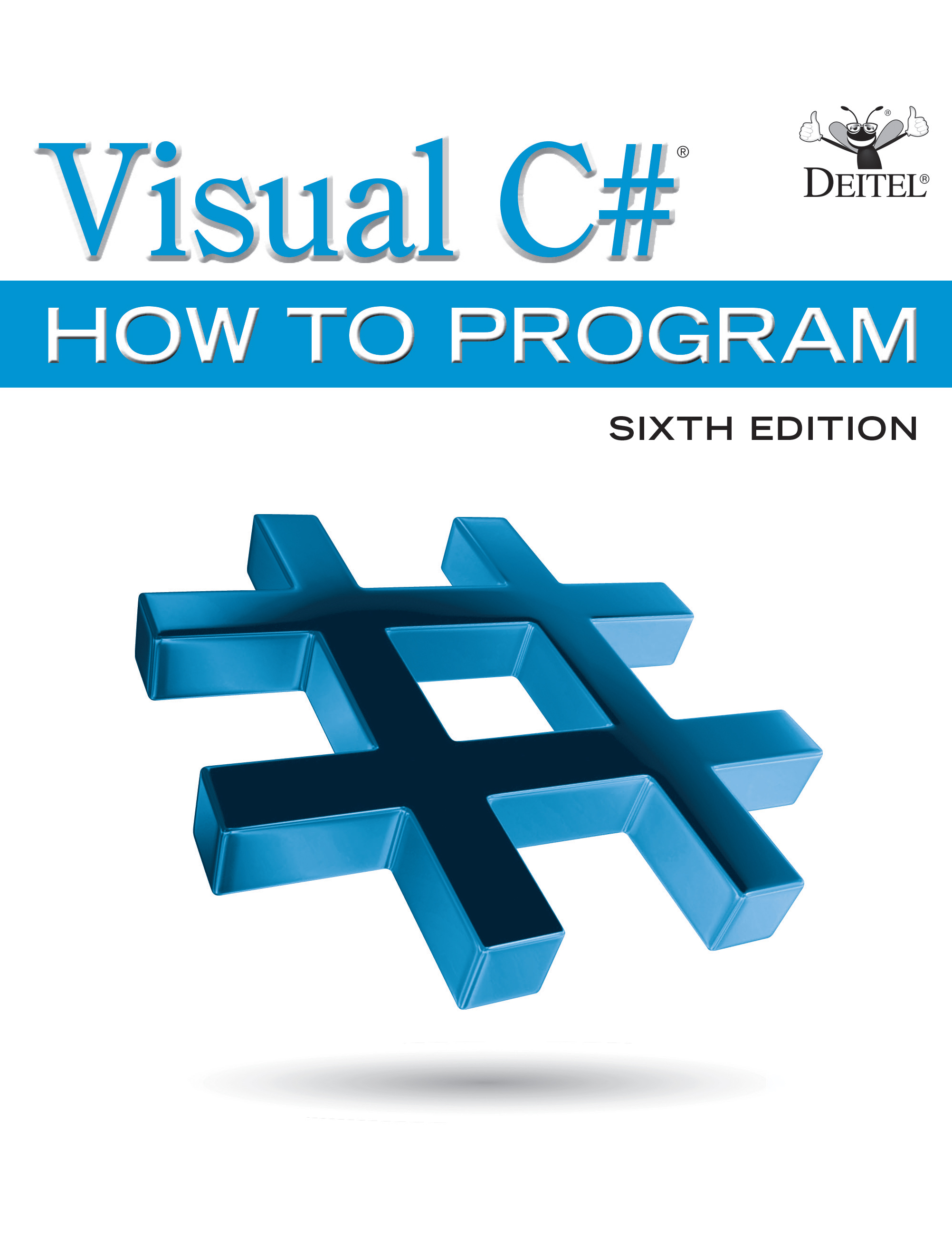
Visual C sharp® How to Program
Sixth Edition
Chapter 16
Strings and Characters: A Deeper Look
Copyright © 2017 Pearson Education, Inc. All Rights Reserved
Notes:
If this PowerPoint presentation contains mathematical equations, you may need to check that your computer has the following installed:
1) MathType Plugin
2) Math Player (free versions available)
3) NVDA Reader (free versions available)

Slide 2
Learning Objectives
Create and manipulate immutable character-string objects of class string and mutable character-string objects of class StringBuilder.
Use various methods of classes string and StringBuilder.
Manipulate character objects of struct Char.
Use regular-expression classes Regex and Match.

Slide 3
Outline (1 of 2)
16.1 Introduction
16.2 Fundamentals of Characters and Strings
16.3 string Constructors
16.4 string Indexer, Length Property and CopyTo Method
16.5 Comparing strings
16.6 Locating Characters and Substrings in strings
16.7 Extracting Substrings from strings
16.8 Concatenating strings
16.9 Miscellaneous string Methods

Slide 4
Outline (2 of 2)
16.10 Class StringBuilder
16.11 Length and Capacity Properties, EnsureCapacity Method and Indexer of Class StringBuilder
16.12 Append and AppendFormat Methods of Class StringBuilder
16.13 Insert, Remove and Replace Methods of Class StringBuilder
16.14 Char Methods
16.15 Introduction to Regular Expressions (Online)
16.16 Wrap-Up

Slide 5
16.2 Fundamentals of Characters and Strings (1 of 6)
Characters are the fundamental building blocks of
source code.
Every program is composed of characters that, when grouped together meaningfully, create a sequence that the compiler interprets as instructions describing how to accomplish a task.
A program also can contain character constants.

Slide 6
16.2 Fundamentals of Characters and Strings (2 of 6)
A character constant is a character that’s represented as an integer value, called a character code.
The integer value 122 corresponds to the character constant 'z'.
The integer value 10 corresponds to the newline character '\n'.
Character constants are established according to the Unicode character set, an international character set that contains many more symbols and letters than does the A S C I I character set (listed in Appendix C).

Slide 7
16.2 Fundamentals of Characters and Strings (3 of 6)
A string is a series of characters treated as a unit. These characters can be uppercase letters, lowercase letters, digits and various special characters: +, -, *, /, $ and others.
A string is an object of class string in the System namespace.
string literals are sequences of characters in double quotation marks
"John Q.Doe"
"9999 Main Street"
"Waltham, Massachusetts"
"(201) 555-1212"

Slide 8

16.2 Fundamentals of Characters and Strings (4 of 6)
A declaration can assign a string literal to a string reference. The declaration

Slide 9
Performance Tip 16.1
If there are multiple occurrences of the same string literal object in an app, a single copy of it will be referenced from each location in the program that uses that string literal. It’s possible to share the object in this manner, because string literal objects are implicitly constant. Such sharing conserves memory.

Slide 10
16.2 Fundamentals of Characters and Strings (5 of 6)
Verbatim Strings
On occasion, a string will contain multiple backslash characters (this often occurs in the name of a file).
To avoid excessive backslash characters, it’s possible to exclude escape sequences and interpret all the characters in a string literally, using the @ character to create what’s known as a verbatim string.
Backslashes within the double quotation marks following the @ character are not considered escape sequences.

Slide 11
16.2 Fundamentals of Characters and Strings (6 of 6)
For example, consider
Using the verbatim string syntax, the assignment can be altered to

Slide 12
16.3 String Constructors
Figure 16.1 demonstrates three string constructors.

Slide 13
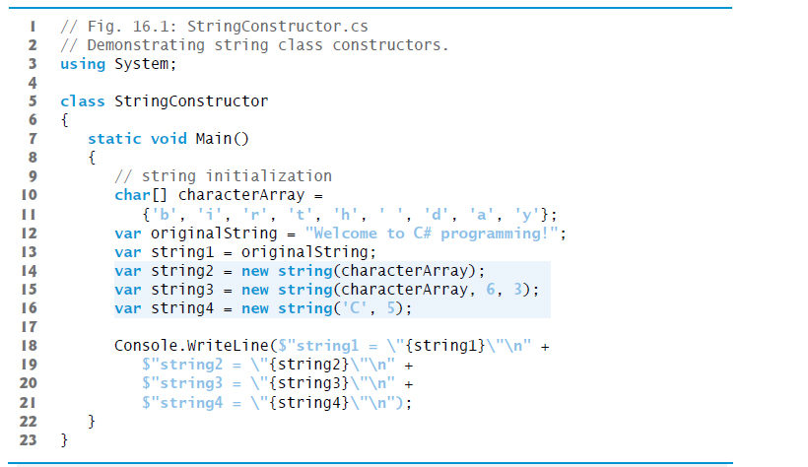
Figure 16.1 Demonstrating String Class Constructors (1 of 2)

Slide 14
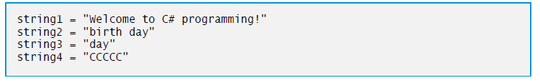
Figure 16.1 Demonstrating String Class Constructors (2 of 2)

Slide 15
Software Engineering Observation 16.1
In most cases, it’s not necessary to make a copy of an existing string. All strings are immutable—their character contents cannot be changed after they’re created. Also, if there are one or more references to a string (or any reference-type object for that matter), the object cannot be reclaimed by the garbage collector.

Slide 16
16.4 String Indexer, Length Property and CopyTo Method
Figure 16.2 presents the string indexer, which facilitates the retrieval of any character in the string, and the string property Length, which returns the length of the string.
The string method CopyTo copies a specified number of characters from a string into a char array.

Slide 17
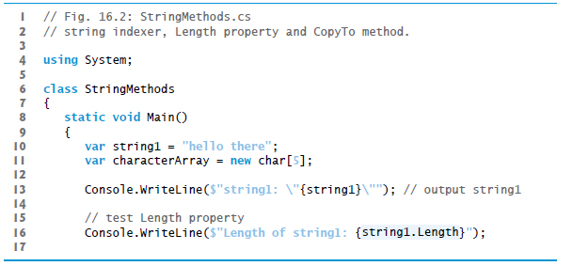
Figure 16.2 String indexer, Length property and CopyTo method (1 of 3)

Slide 18
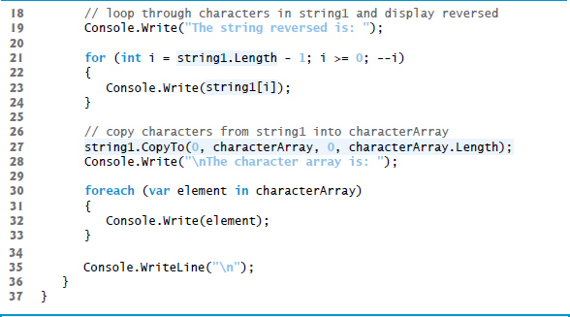
Figure 16.2 String indexer, Length property and CopyTo method (2 of 3)

Slide 19
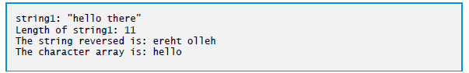
Figure 16.2 String indexer, Length property and CopyTo method (3 of 3)

Slide 20
Common Programming Error 16.1
Attempting to access a character that’s outside a string’s bounds results in an Index-OutOfRangeException

Slide 21
16.5 Comparing Strings (1 of 2)
Class string provides several ways to compare strings.
Figure 16.3 demonstrates method Equals, method CompareTo and the equality operator

Slide 22
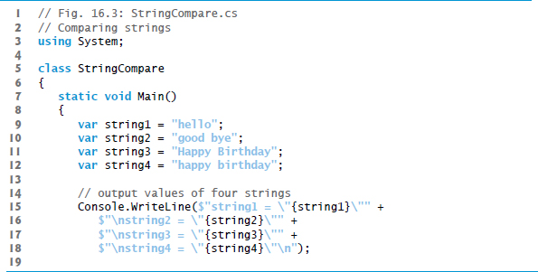
Figure 16.3 Comparing Strings (1 of 4)

Slide 23
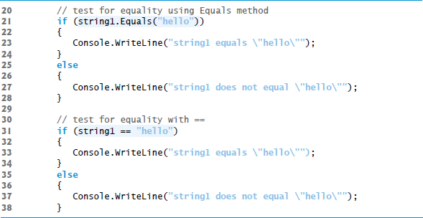
Figure 16.3 Comparing Strings (2 of 4)

Slide 24
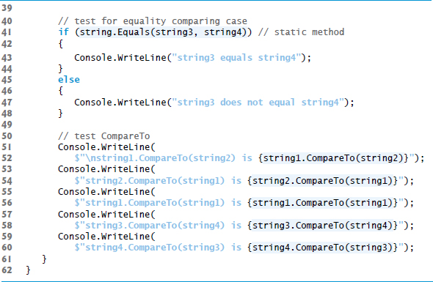
Figure 16.3 Comparing Strings (3 of 4)

Slide 25
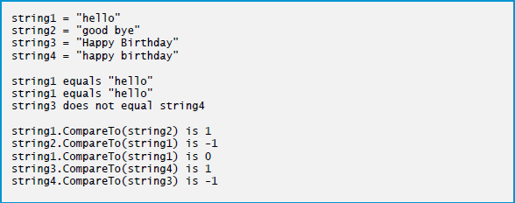
Figure 16.3 Comparing Strings (4 of 4)

Slide 26
16.5 Comparing Strings (2 of 2)
Figure 16.4 shows how to test whether a string instance begins or ends with a given string.

Slide 27
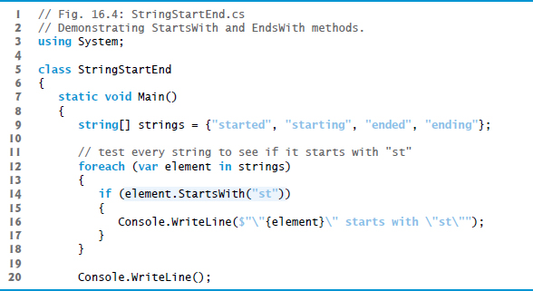
Figure 16.4 Demonstrating StartsWith and EndsWith methods (1 of 2)

Slide 28
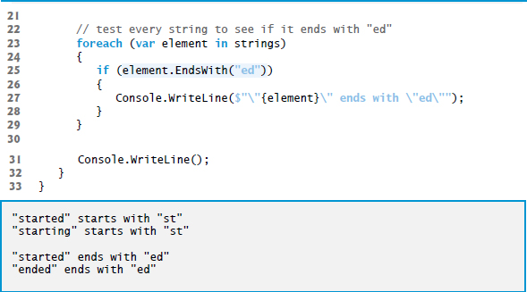
Figure 16.4 Demonstrating StartsWith and EndsWith methods (2 of 2)

Slide 29
16.6 Locating Characters and Substrings in Strings
In many apps, it’s necessary to search for a character or set of characters in a string.
For example, a programmer creating a word processor would want to provide capabilities for searching through documents.
Figure 16.5 demonstrates some of the many versions of string methods IndexOf, IndexOfAny, LastIndexOf and LastIndexOfAny, which search for a specified character or substring in a string.
We perform all searches in this example on the string letters (initialized with "abcdefghijklmabcdefghijklm") located in method Main of class StringIndexMethods.

Slide 30
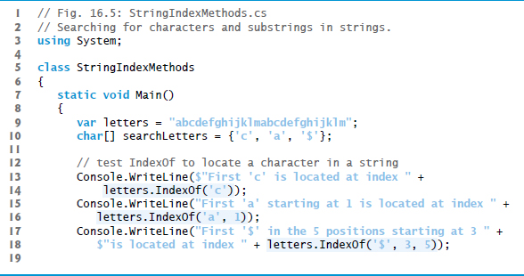
Figure 16.5 Using String-Searching Methods (1 of 5)

Slide 31
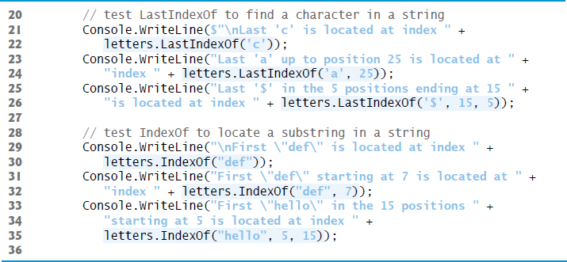
Figure 16.5 Using String-Searching Methods (2 of 5)

Slide 32
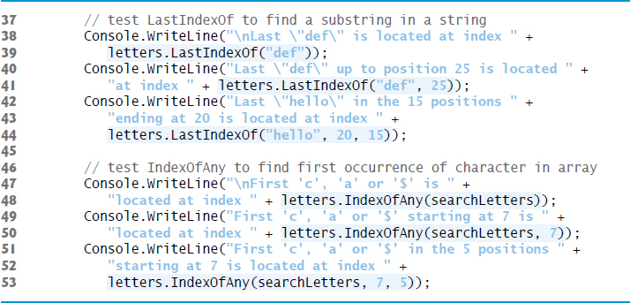
Figure 16.5 Using String-Searching Methods (3 of 5)

Slide 33
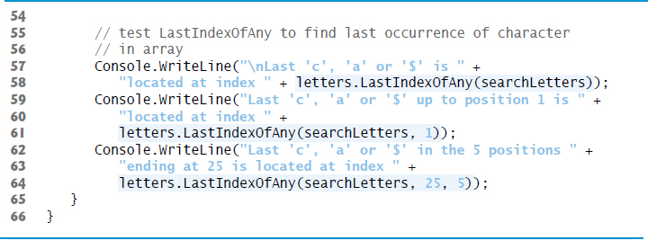
Figure 16.5 Using String-Searching Methods (4 of 5)

Slide 34
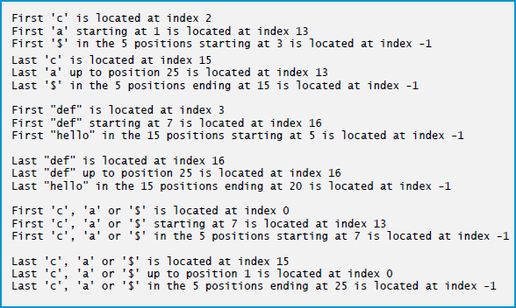
Figure 16.5 Using String-Searching Methods (5 of 5)

Slide 35
Common Programming Error 16.2
In the overloaded methods LastIndexOf and LastIndexOfAny that take three parameters, the second argument must be greater than or equal to the third. This might seem counterintuitive, but remember that the search moves from the end of the string toward the start of the string.

Slide 36
16.7 Extracting Substrings from Strings
Class string provides two Substring methods, which create a new string by copying part of an existing string.
Each method returns a new string.
Figure 16.6 demonstrates the use of both methods.

Slide 37
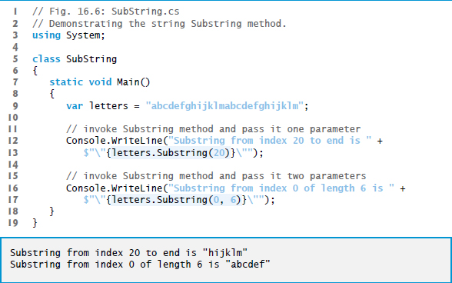
Figure 16.6 Demonstrating the String Substring Method

Slide 38
16.8 Concatenating Strings
The + operator is not the only way to perform string concatenation.
The static method Concat of class string (Figure 16.7) concatenates two strings and returns a new string containing the combined characters from both original strings.

Slide 39
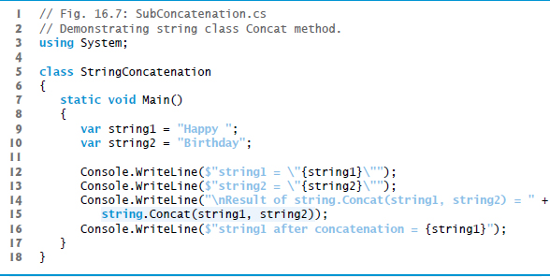
Figure 16.7: Demonstrating String Class Concat Method (1 of 2)

Slide 40
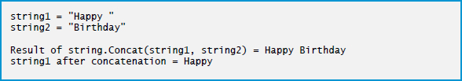
Figure 16.7: Demonstrating String Class Concat Method (2 of 2)

Slide 41
16.9 Miscellaneous string Methods
Class string provides several methods that return modified copies of strings.
The app in Figure 16.8 demonstrates string methods Replace, ToLower, ToUpper and Trim.

Slide 42
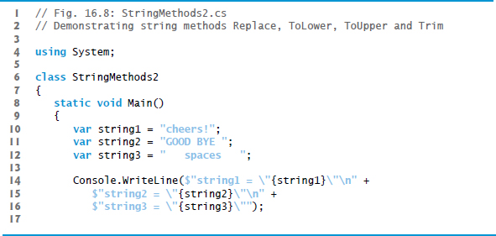
Figure 16.8 Demonstrating String Methods Replace, ToLower, ToUpper and Trim (1 of 3)

Slide 43
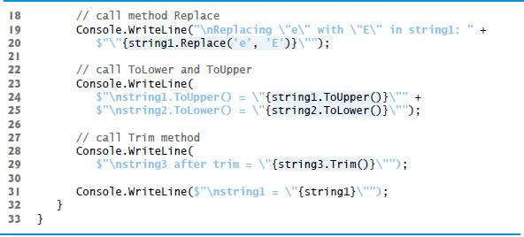
Figure 16.8 Demonstrating String Methods Replace, ToLower, ToUpper and Trim (2 of 3)

Slide 44
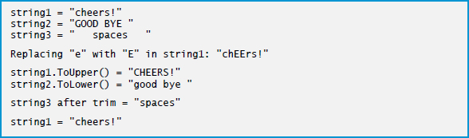
Figure 16.8 Demonstrating String Methods Replace, ToLower, ToUpper and Trim (3 of 3)

Slide 45
16.11 Class StringBuilder (1 of 3)
The string class provides many capabilities for processing strings.
However a string’s contents can never change.
Operations that seem to concatenate strings are in fact
creating new strings—the
operator creates a new string
and assigns its reference to the variable on the left of the
operator.
Every StringBuilder can store a certain number of characters that’s specified by its capacity.
Exceeding the capacity of a StringBuilder causes the capacity to expand to accommodate the additional characters.

Slide 46
16.11 Class StringBuilder (2 of 3)
StringBuilder methods Append and AppendFormat can be used for concatenation like the operators + and
for class string.
StringBuilder is particularly useful for manipulating in place a large number of strings, as it’s much more efficient than creating individual immutable strings.

Slide 47
Performance Tip 16.2
Objects of class string are immutable (i.e., constant strings), whereas objects of class StringBuilder are mutable.
can perform certain optimizations involving strings (such as the sharing of one string among multiple references), because it knows these objects will not change.

Slide 48
16.11 Class StringBuilder (3 of 3)
Class StringBuilderConstructor (Figure 16.9) demonstrates some StringBuilder overloaded constructors.

Slide 49
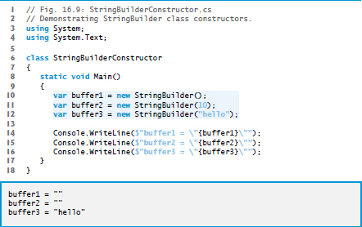
Figure 16.9 Demonstrating StringBuilder Class Constructors

Slide 50
16.11 Length and Capacity Properties, EnsureCapacity Method and Indexer of Class StringBuilder
Class StringBuilder provides the Length and Capacity properties to return the number of characters currently in a StringBuilder and the number of characters that a StringBuilder can store without allocating more memory, respectively.
These properties also can increase or decrease the length or the capacity of the StringBuilder. Method EnsureCapacity allows you to reduce the number of times that a StringBuilder’s capacity must be increased.
The method ensures that the StringBuilder’s capacity is at least the specified value.
The program in Figure 16.10 demonstrates these methods and properties.

Slide 51
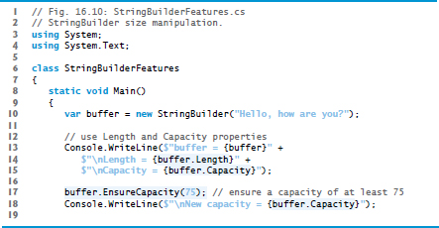
Figure 16.10 StringBuilder size manipulation (1 of 2)

Slide 52
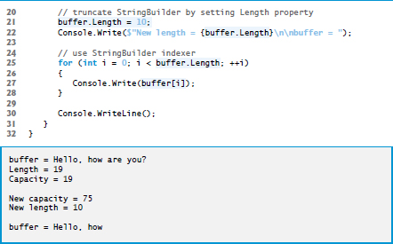
Figure 16.10 StringBuilder size manipulation (2 of 2)

Slide 53
16.12 Append and AppendFormat Methods of Class StringBuilder (1 of 2)
Class StringBuilder provides overloaded Append methods that allow various types of values to be added to the end of a StringBuilder.
The Framework Class Library provides versions for each of the simple types and for character arrays, strings and objects.
Each method takes an argument, converts it to a string and appends it to the StringBuilder.
Figure 16.11 demonstrates several Append methods.

Slide 54
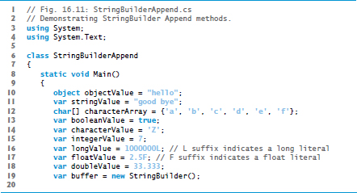
Figure 16.11 Demonstrating StringBuilder Append methods (1 of 3)

Slide 55
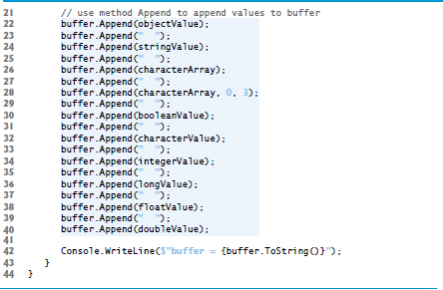
Figure 16.11 Demonstrating StringBuilder Append methods (2 of 3)

Slide 56
Figure 16.11 Demonstrating StringBuilder Append methods (3 of 3)

Slide 57
16.12 Append and AppendFormat Methods of Class StringBuilder (2 of 2)
Figure 16.11 demonstrates the AppendFormat method.

Slide 58
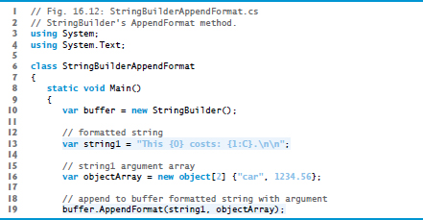
Figure 16.12 Demonstrating Method AppendFormat (1 of 3)

Slide 59
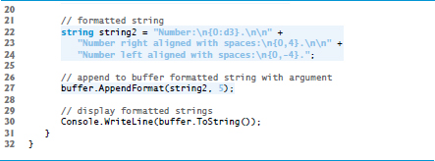
Figure 16.12 Demonstrating Method AppendFormat (2 of 3)

Slide 60
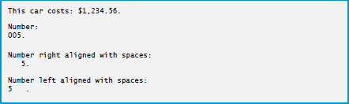
Figure 16.12 Demonstrating Method AppendFormat (3 of 3)

Slide 61
16.13 Insert, Remove and Replace Methods of Class StringBuilder (1 of 3)
Class StringBuilder provides overloaded Insert methods to allow various types of data to be inserted at any position in a StringBuilder.
The class provides versions for each of the simple types and for character arrays, strings and objects.
Each method takes its second argument, converts it to a string and inserts the string into the StringBuilder in front of the character in the position specified by the first argument.
The index specified by the first argument must be greater than or equal to 0 and less than the length of the StringBuilder; otherwise, the program throws an ArgumentOutOfRangeException.

Slide 62
16.13 Insert, Remove and Replace Methods of Class StringBuilder (2 of 3)
Class StringBuilder also provides method Remove for deleting any portion of a StringBuilder.
Method Remove takes two arguments—the index at which to begin deletion and the number of characters to delete.
The sum of the starting index and the number of characters to be deleted must always be less than the length of the StringBuilder ; otherwise, the program throws an ArgumentOutOfRangeException.
The Insert and Remove methods are demonstrated in Figure 16.13.

Slide 63
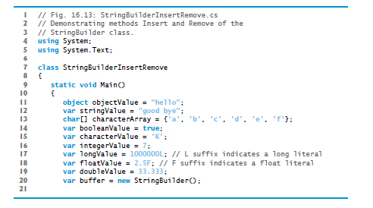
Figure 16.13 Demonstrating methods Insert and Remove of class StringBuilder (1 of 3)

Slide 64
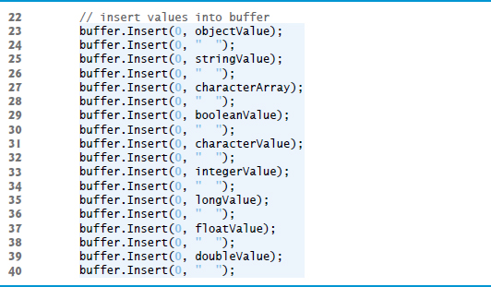
Figure 16.13 Demonstrating methods Insert and Remove of class StringBuilder (2 of 3)

Slide 65
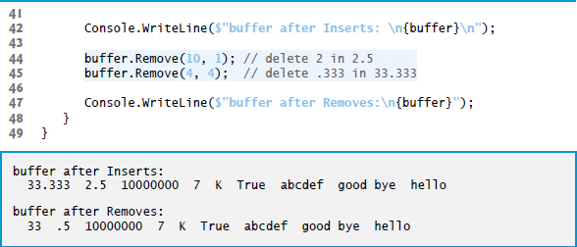
Figure 16.13 Demonstrating methods Insert and Remove of class StringBuilder (3 of 3)

Slide 66
16.13 Insert, Remove and Replace Methods of Class StringBuilder (3 of 3)
StringBuilder method Replace searches for a specified string or character and substitutes another string or character in its place.
Figure 16.14 demonstrates this method.

Slide 67
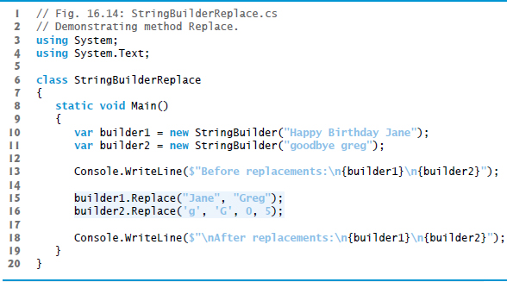
Figure 16.14 Demonstrating method Replace (1 of 2)

Slide 68
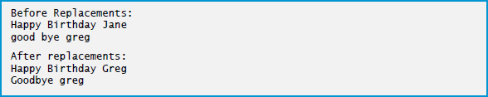
Figure 16.14 Demonstrating method Replace (2 of 2)

Slide 69
16.14 Char Methods
Figure 16.15 demonstrates static methods that test characters to determine whether they’re of a specific character type and static methods that perform case conversions on characters.

Slide 70
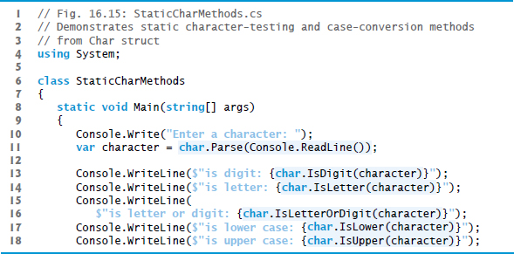
Figure 16.15 Demonstrates Static Character-Testing and Case-Conversion Methods from Char Struct (1 of 4)

Slide 71
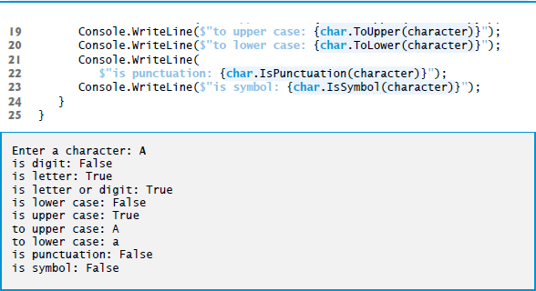
Figure 16.15 Demonstrates Static Character-Testing and Case-Conversion Methods from Char Struct (2 of 4)

Slide 72
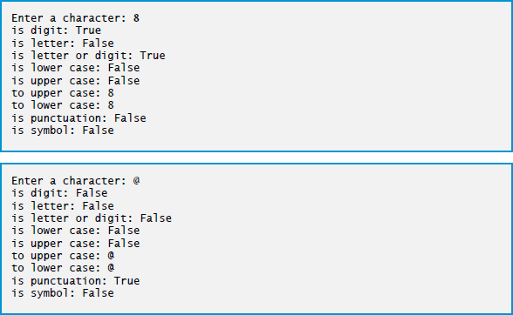
Figure 16.15 Demonstrates Static Character-Testing and Case-Conversion Methods from Char Struct (3 of 4)

Slide 73
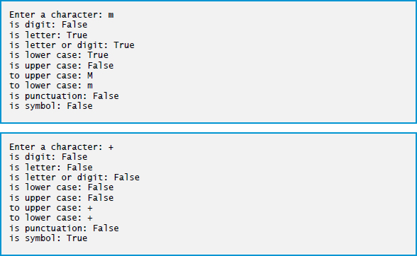
Figure 16.15 Demonstrates Static Character-Testing and Case-Conversion Methods from Char Struct (4 of 4)

Slide 74

Copyright

